Slide 1
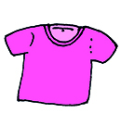
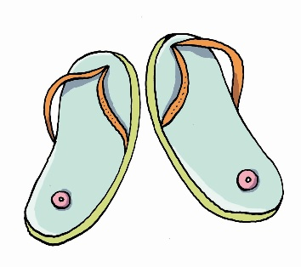
The T-shirt is just right.
T-shirt
The flip-flops are just right.
flip-flops

Slide 2
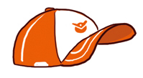
The cap is just right.
1 cap
The caps are just right.
2 caps

Slide 3

The shoe is just right.
1 shoe
The shoes are just right.
2 shoes

Slide 4
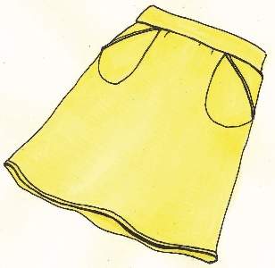
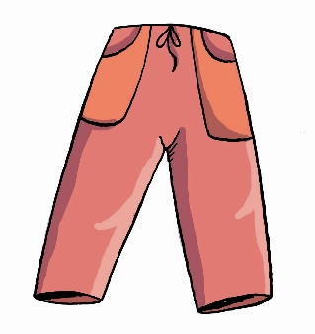
The skirt is just right.
skirt
The trousers are just right.
trousers

